Slide 1
Final Project Presentation Members and Topics: Jonathan: Intro and Goals, and Parts Jose: Challenges, Solutions, and Project Outcomes Devin: PCB Design Binh: Conclusion and Q&A

Slide 2
Project analysis slide 2
Project Introduction
Today’s Topics
Objectives and Goals
Parts through the project
Challenges and Solutions
Outcomes
Schematic and PCB Design
What would we do differently?
Conclusion and Q&A

Slide 3
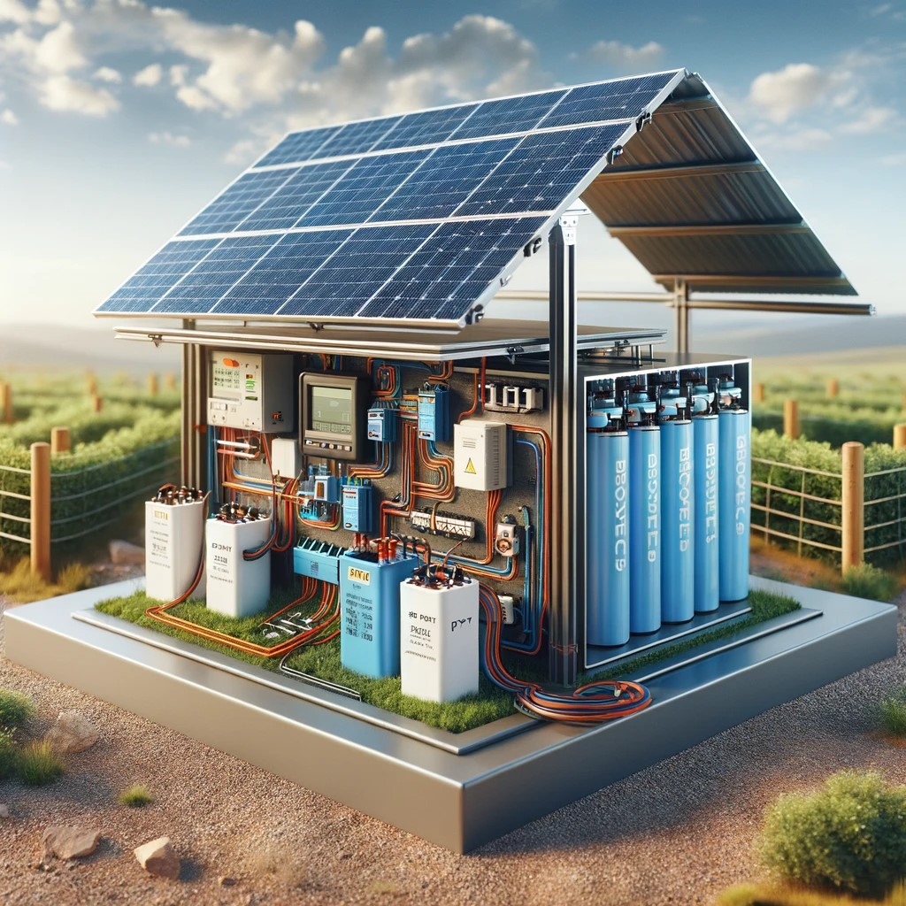
Project analysis slide 2
Project Introduction
Goals/Objectives
The primary goal of this project was to design, construct, and demonstrate a fully operational PV-Battery Integrated Energy System. Our team mainly focused on the integration of key components such as gate drivers, a noninverting DC-DC converter, a Bi-directional DC-DC converter, as well as using an Arduino Uno for system control.

Slide 4
Parts Through the Project

Slide 5
Project analysis slide 10
Parts Through the Project
Ordered Parts
Part Name | Part # | Quantity | Unit Price | Total Price
MOSFET (10pcs) | LRF540 | 1 | $7.99 | $7.99
Diode | 863-IN4002G | 10 | $0.19 | $1.90
Inductor 100mH | 580-19R107C | 10 | $1.47 | $14.70
Capacitor 47 uF | 80-ESW476M035AE3AA | 10 | $0.27 | $2.70
Capacitor 470 uF | 80-ESK477M035AH2EA | 10 | $0.50 | $5.00
Voltage Regulator 5V | 511-L7805CV | 5 | $0.69 | $3.45
USB 2.0 Port | 530-SS-52100-001 | 5 | $0.56 | $2.80
Gate Driver | 942-IR2110PBF | 5 | $2.92 | $14.60
Arduino Micro | A000053 | 1 | $23.95 | $23.95
Breadboard (10pcs) | pcb5 | 1 | $19.99 | $19.99
ACS712 Current Sensor Module (5pcs) | TS-US-158-CA | 1 | $9.49 | $9.49
Overture PETG Filament 1.75mm Grey, 1kg | ‎OVPETG175 | 1 | $21.99 | $21.99
Arduino Uno REV3 | A000066 | 1 | $27.60 | $27.60
Gross Cost | $156.16
Net Cost | $169.04
Remaining Budget | $60.96

Slide 6
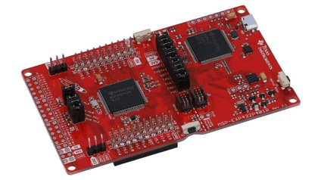

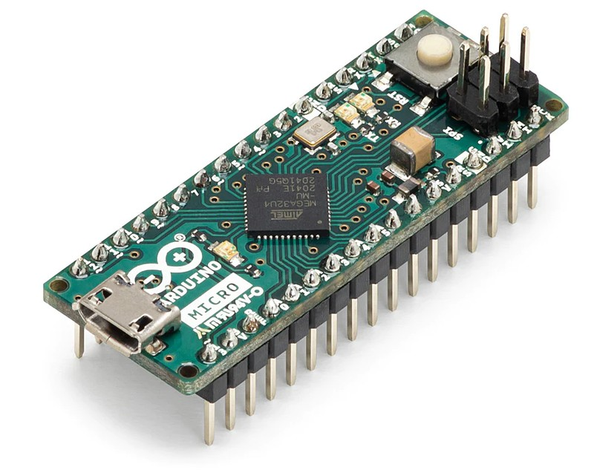
Project analysis slide 10
Parts Through the Project
Microcontroller Troubles
MSP-432
Arduino Micro
Arduino Uno R3

Slide 7
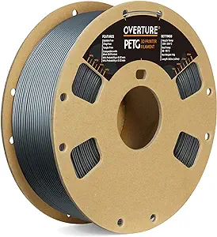
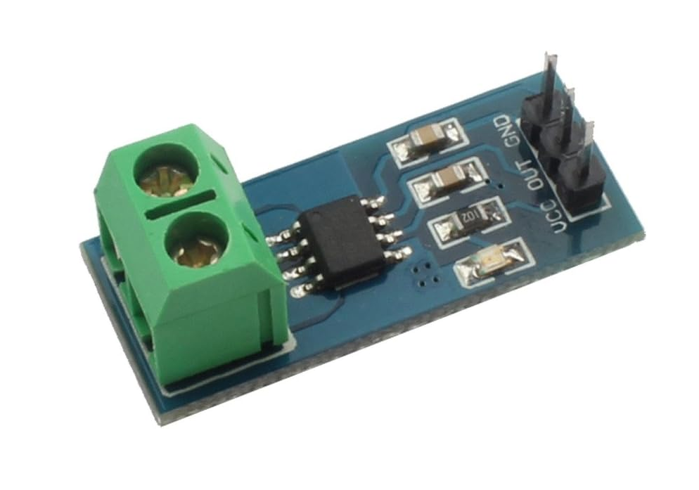
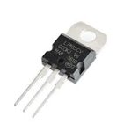
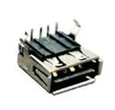
Project analysis slide 10
Parts Through the Project
Other Parts and Things
Other parts of interest include:
L7805CV 5V Regulator
USB 2.0 Port
ACS712 5A Current Sensor Module
Overture PETG Filament

Slide 8
Challenges and Solutions

Slide 9
Project analysis slide 3
Challenges and Solutions
Predicted Challenges
Possible Solutions
If, during the testing phase, the load receives too much power, there is a chance we could damage it.
The biggest challenge of this process will be the bidirectional circuit. This sub circuit will need to have a mechanism in which it allows the battery to be charged and discharged when not enough solar energy is being supplied to the load.
If there is a sudden drop in solar energy, we risk not supplying energy from the battery fast enough. We will need to ensure there is a smooth transition of power from the solar panel and battery.
Use the L7805CV 5V voltage regulator to ensure the load never receives too much power.
Use a microcontroller to mathematically calculate what should be happening at any time.
Use larger capacitors in some areas to ensure smooth transitions.

Slide 10
Project analysis slide 3
Challenges and Solutions
Challenges Throughout
Possible Solutions
Coding the Arduino to accurately control the gate driver, in turn accurately controlling the dc-dc converters
Deriving an efficient method/algorithm for determining the MPPT based on V x I measurements(then implementing the code correctly)
Determining a method for regulating the load voltage and current, as well as ensuring the battery gets the voltage it needs to be charged
Review the code and change to more efficient methods of timing.
Use source code from other projects found online and manipulate it to what we want.
We determined we will need a feedback loop in our Bidirectional DC-DC, we will need to figure out the implementation steps required.

Slide 11
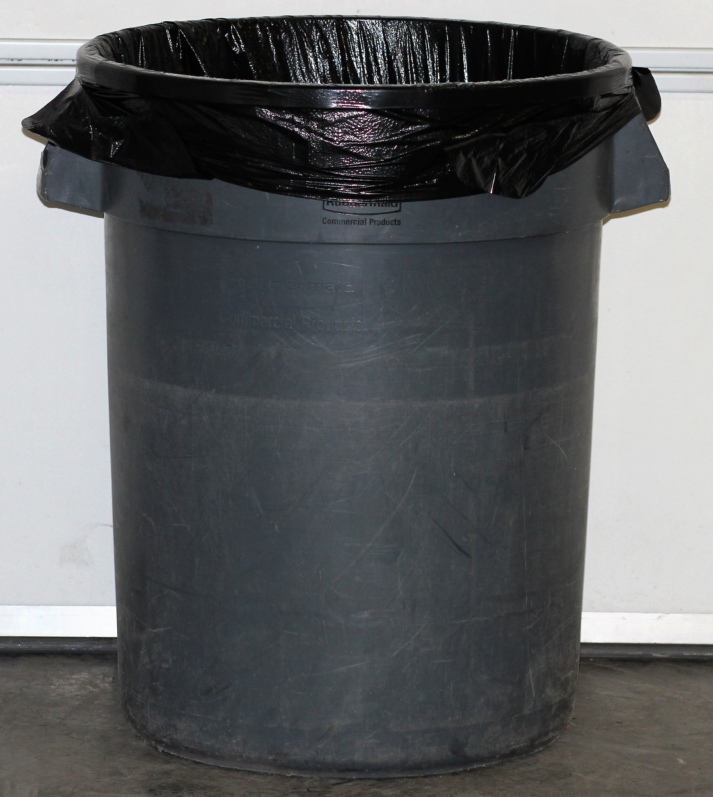
Project analysis slide 3
Challenges and Solutions
Setbacks
Solutions
Trouble coding with the Arduino Micro, specifically with the timers, it was difficult to be able to produce 4 PWM signals at a high enough frequency for our circuit
Incorrect implementation of the gate driver
Damaged our last Gate Driver IC
Replaced the Micro with the Uno, this immediately resolved multiple issues regarding programming
We were able to measure the output of the pins in the circuit to determine where the gate driver needed to be adjusted
Bought 4 more

Slide 12
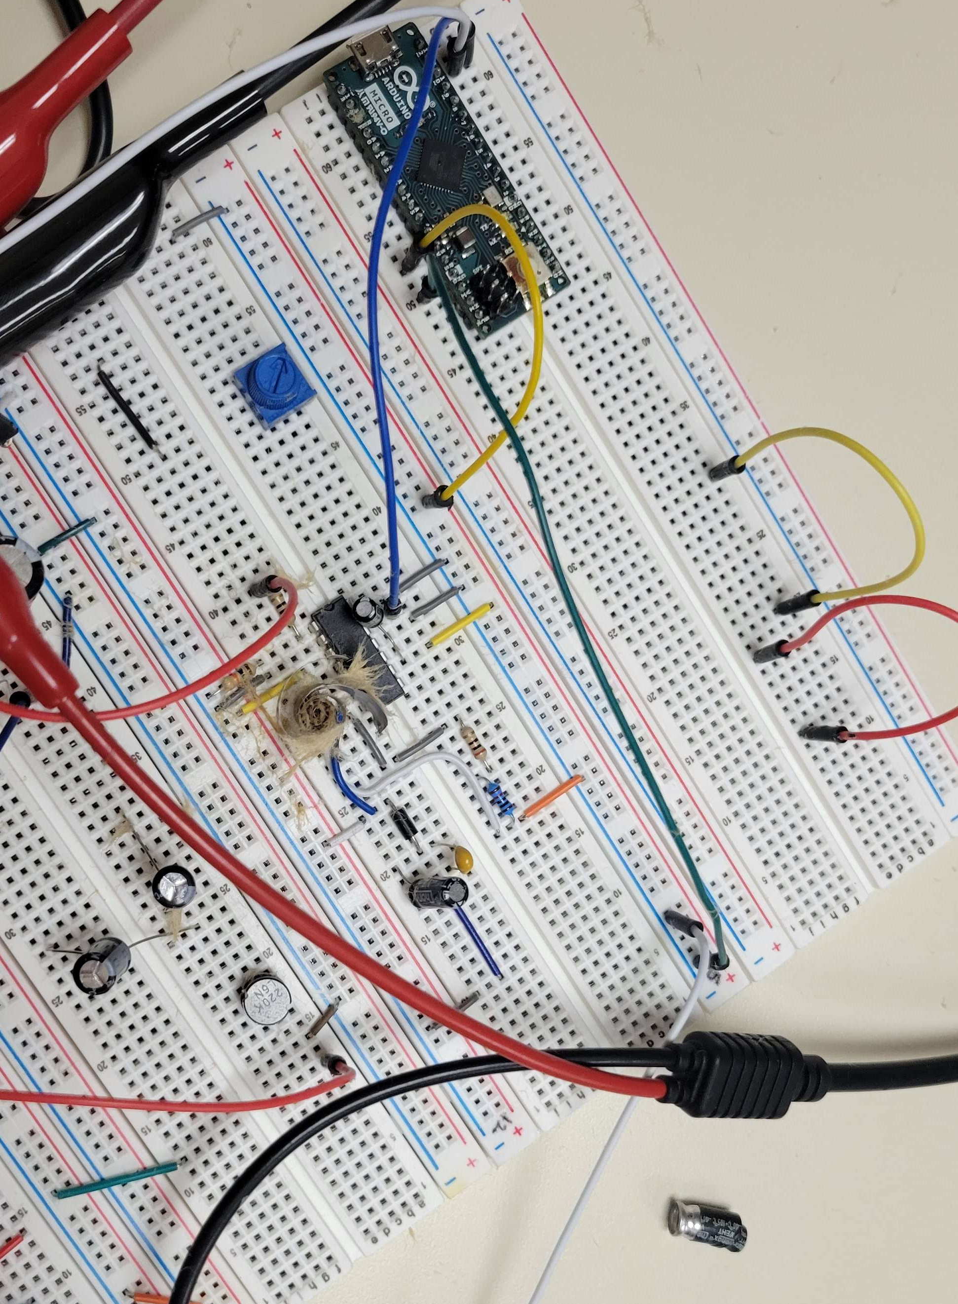

Slide 13
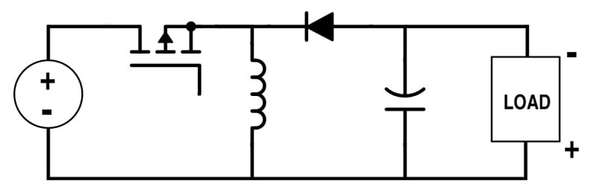
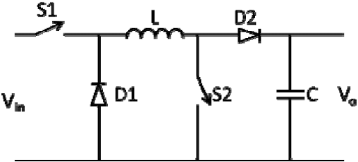
Project analysis slide 3
Challenges and Solutions
Exchanged from classic buck-boost converter to non-inverting buck-boost converter, since we need a positive node at
However, this circuit does introduce some more complexities since it requires another switch

Slide 14
Outcomes

Slide 15
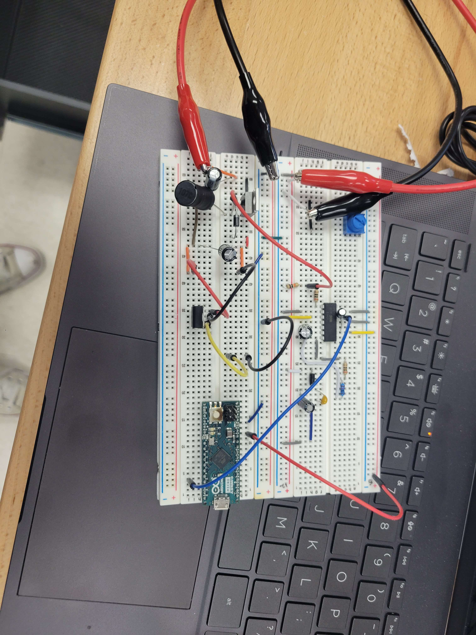
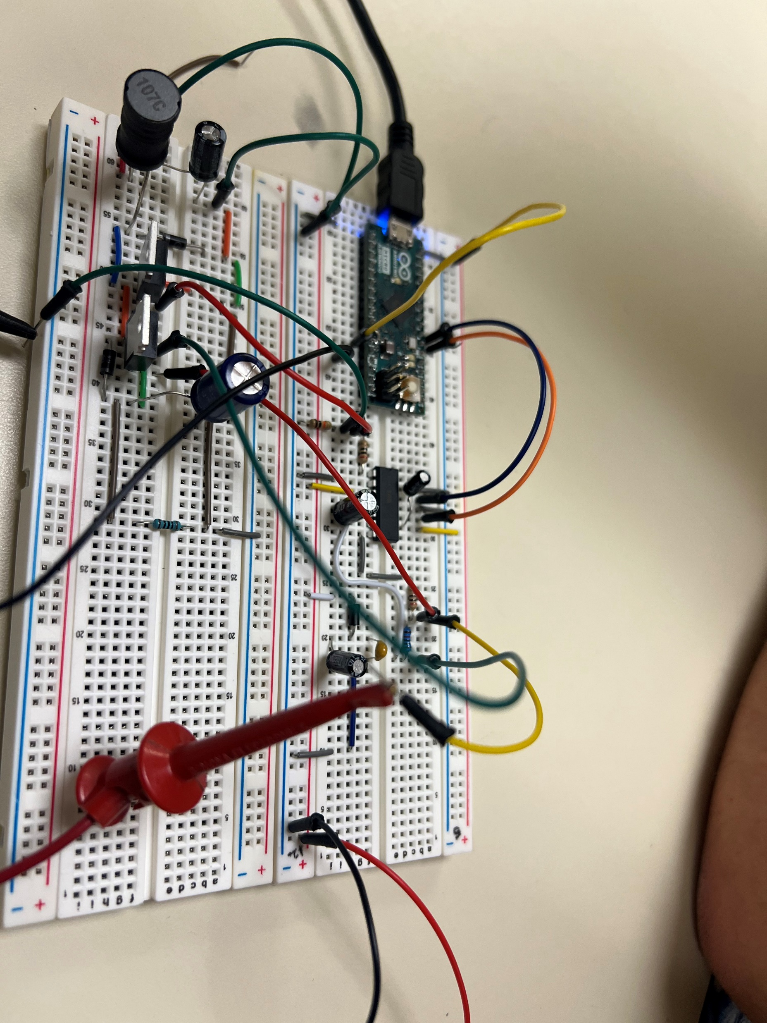
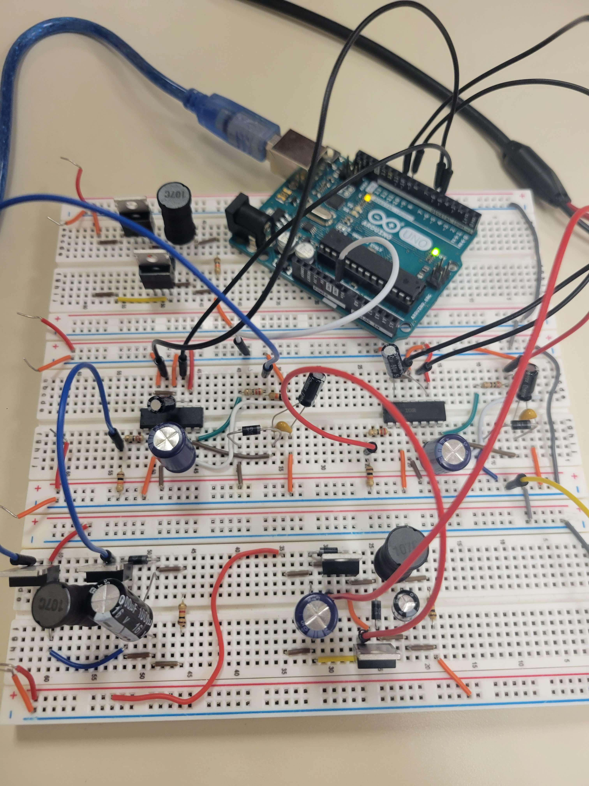
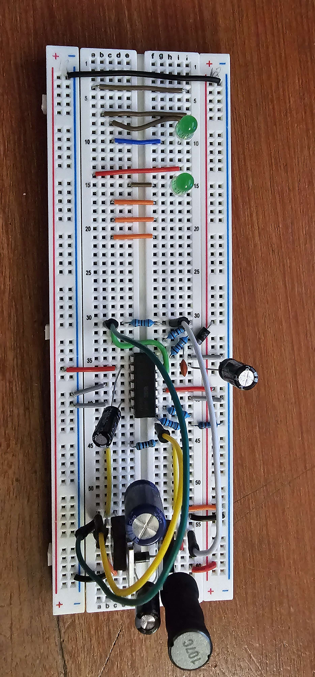
Evolution Of Our Prototype
Prototype 1
Prototype 2
Final Prototype

Slide 16
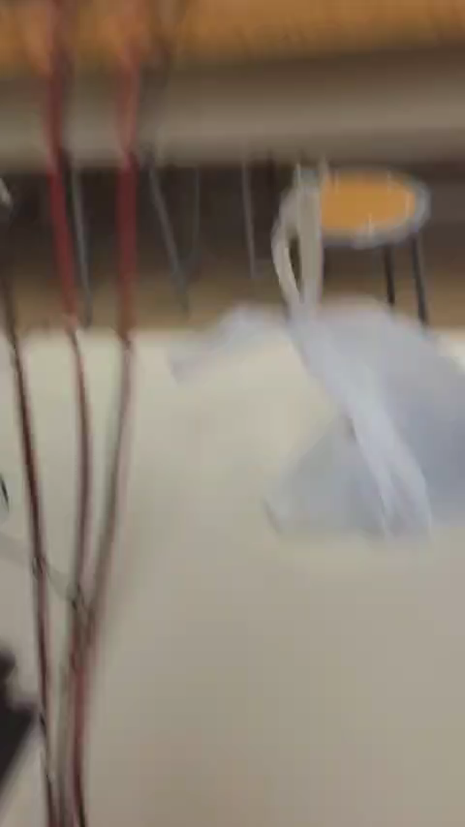
Project analysis slide 4
Project Operation
Here we simulated our PV array from the DC power supply and had our input as 3V and 1A. We successfully showed that our input could be boosted from 3V to the 5V with the non-inverting DC-DC converter. This would then give the phone the voltage that it would need to begin charging.

Slide 17
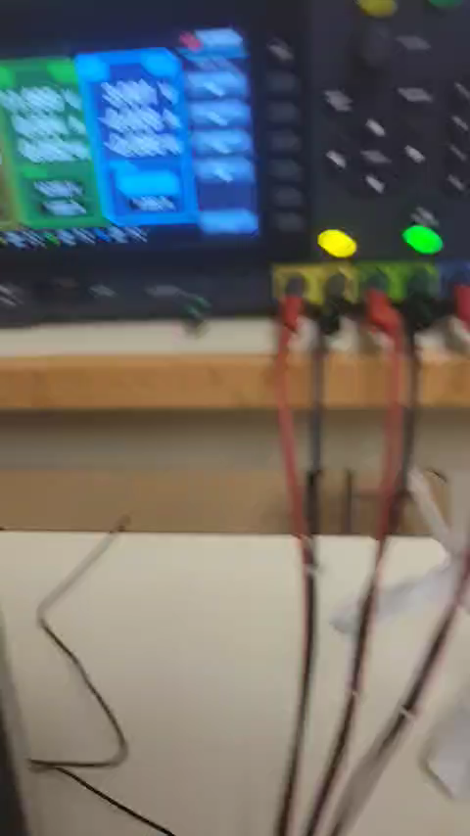
Project analysis slide 4
Project Operation
Here we were able to simulate the non-inverting DC-DC converter to be the input to the bi-directional DC-DC converter, which would then allow the battery to be charged. It should be noted that the load would be in parallel with the non-inverting DC-DC converter along with the bi-directional DC-DC converter. The resistor in this case is being showcased as the battery, the bi-directional DC-DC converter can reach 12V.

Slide 18
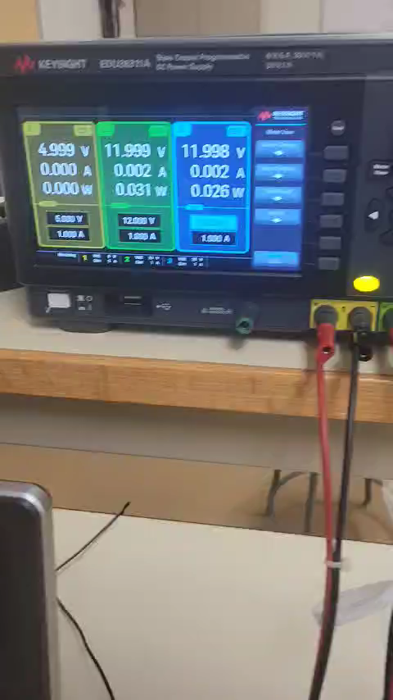
Project analysis slide 4
Project Operation
This final simulation shows the case in which the PV array is either off or supplying very little power. The battery will act as a voltage source and then the directionality of the bi-directional DC-DC converter will reverse, thereby supplying power to the load. The resistor in this case is our phone charger.

Slide 19
Schematic and PCB Design

Slide 20
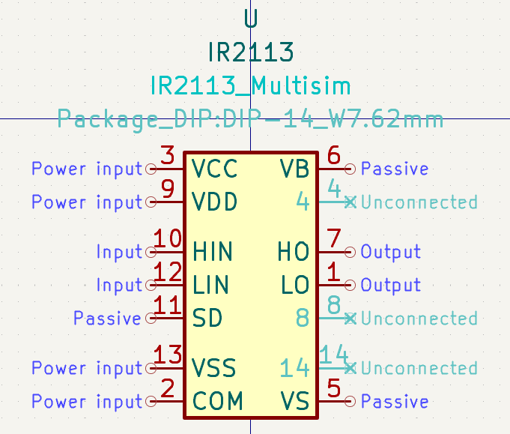
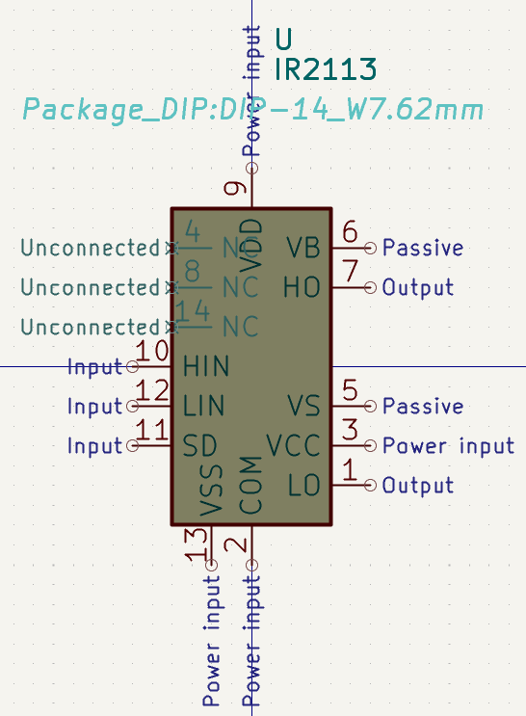
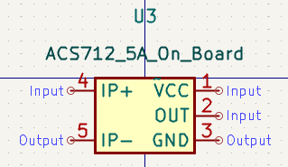
Project analysis slide 10
Schematic Design
Custom Footprints

Slide 21
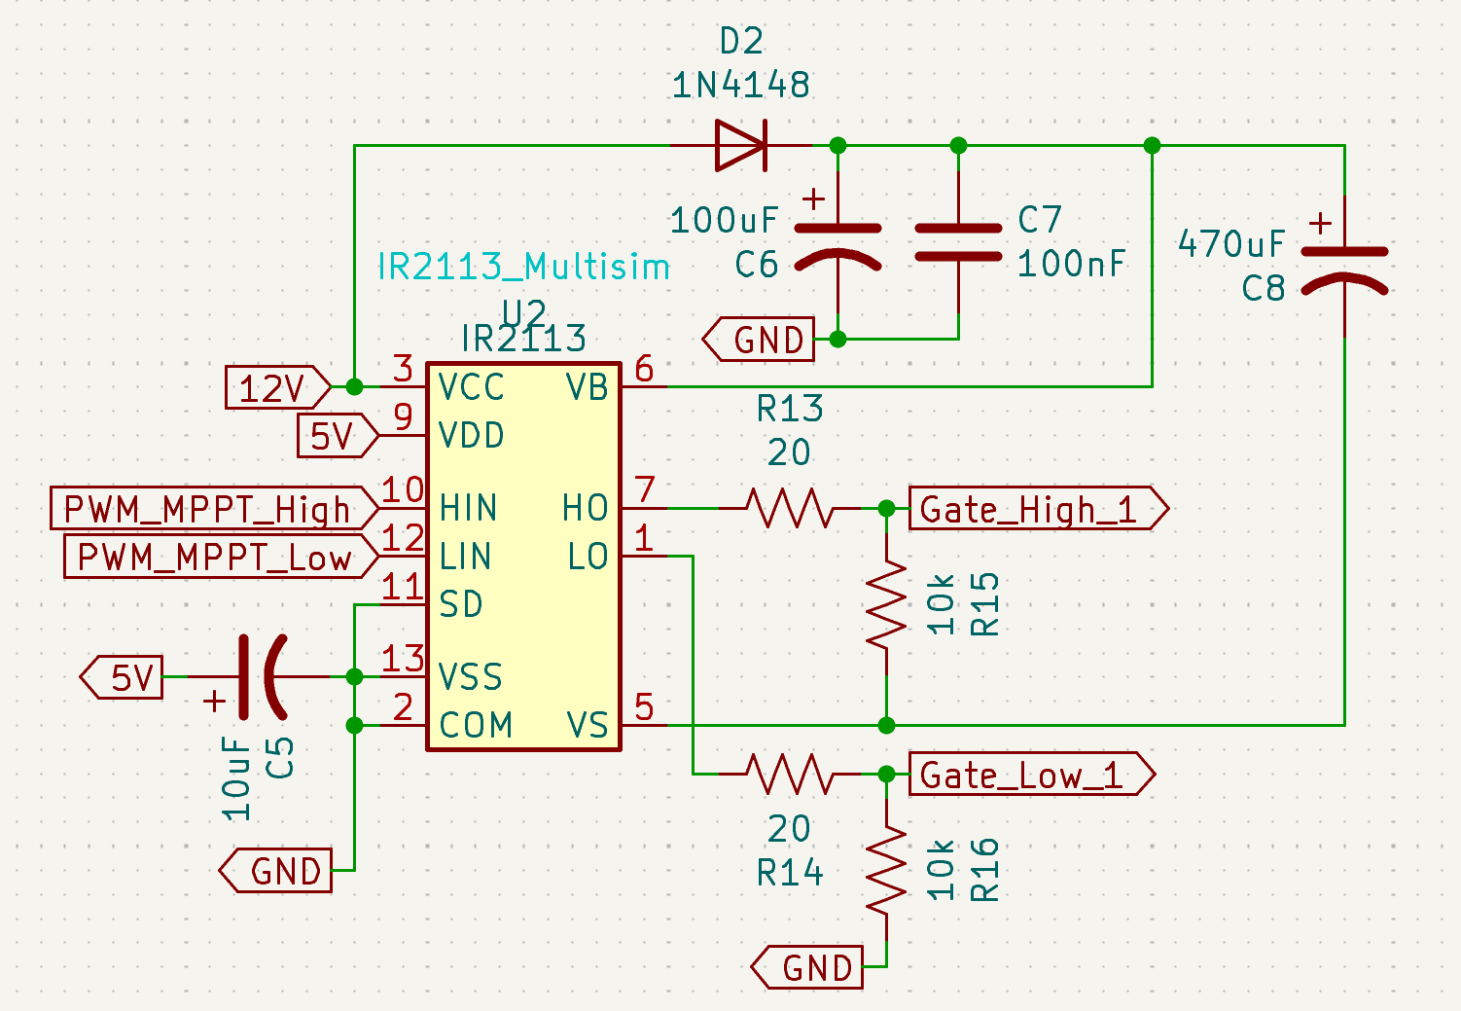
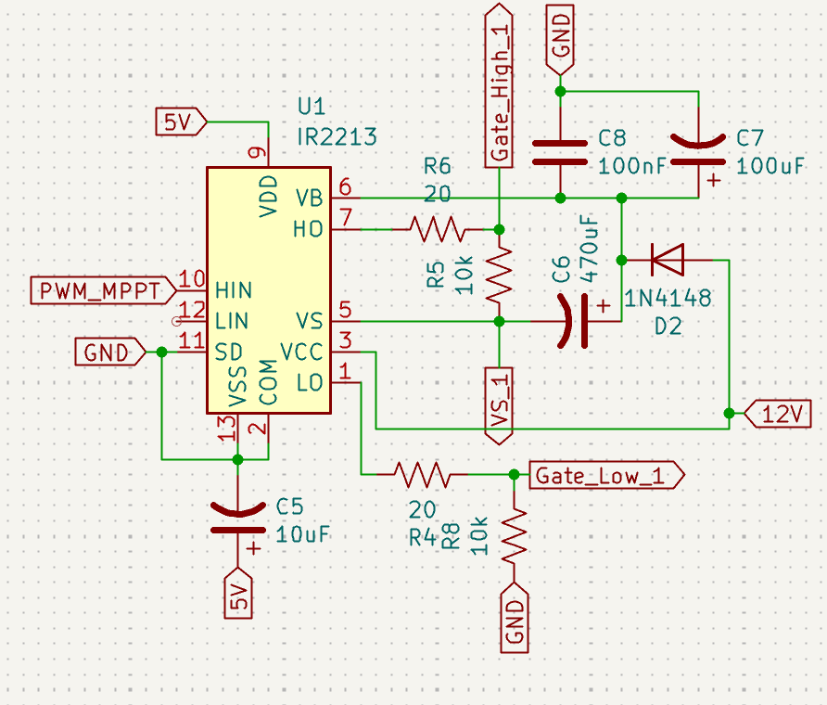
Project analysis slide 10
Schematic Design
Gate Driver Circuit

Slide 22
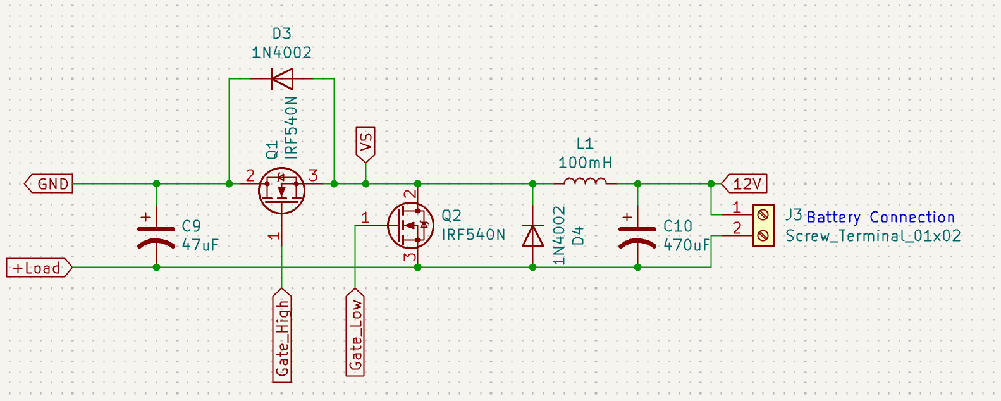
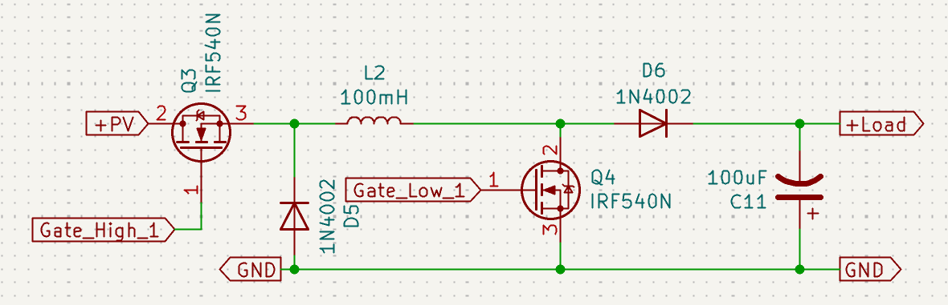
Project analysis slide 10
Schematic Design
DC-DC Converters

Slide 23
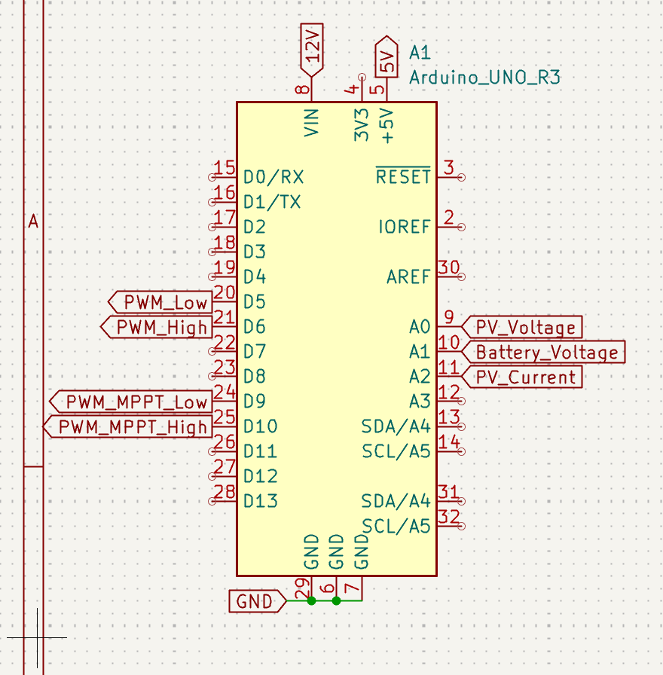
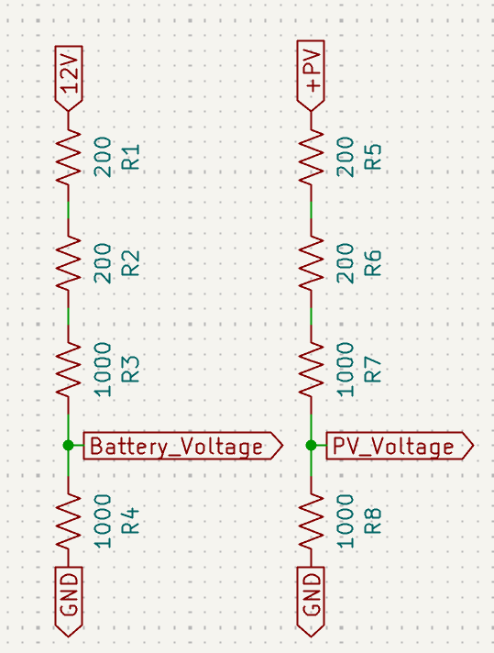
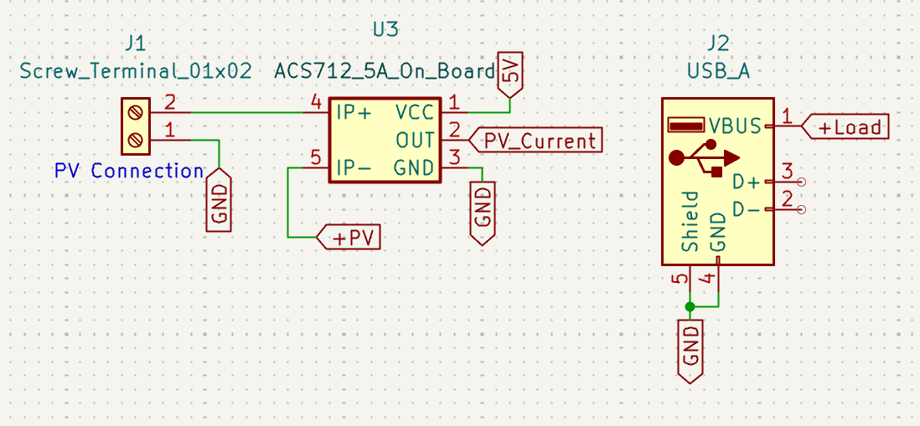
Project analysis slide 10
Schematic Design
Controllers, Sensors, Terminals

Slide 24
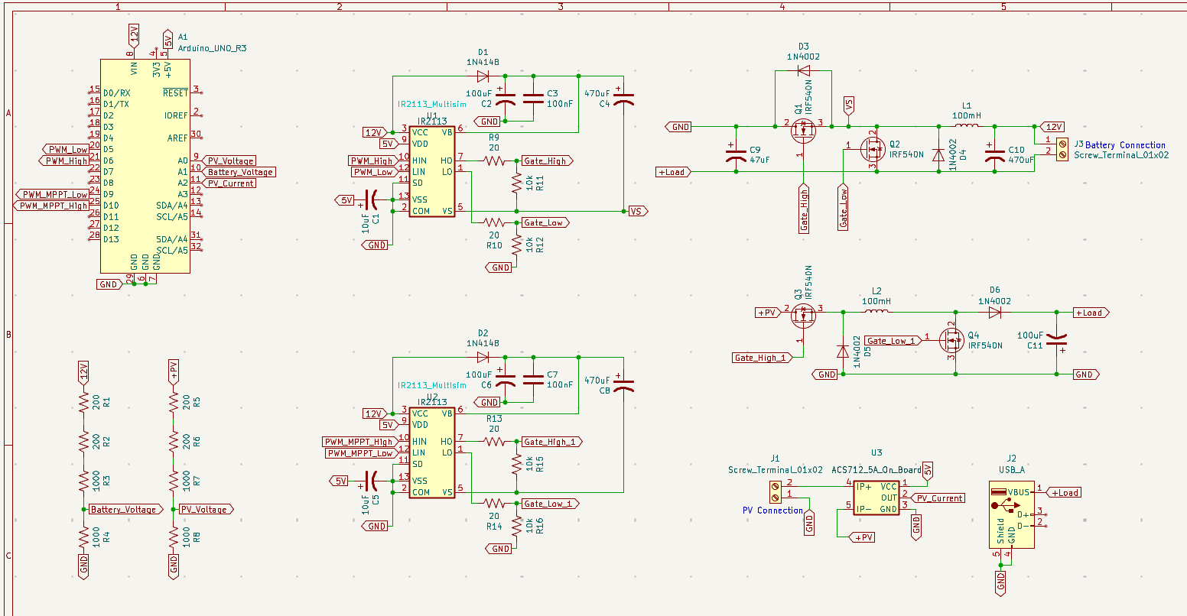
Project analysis slide 10
Schematic Design

Slide 25
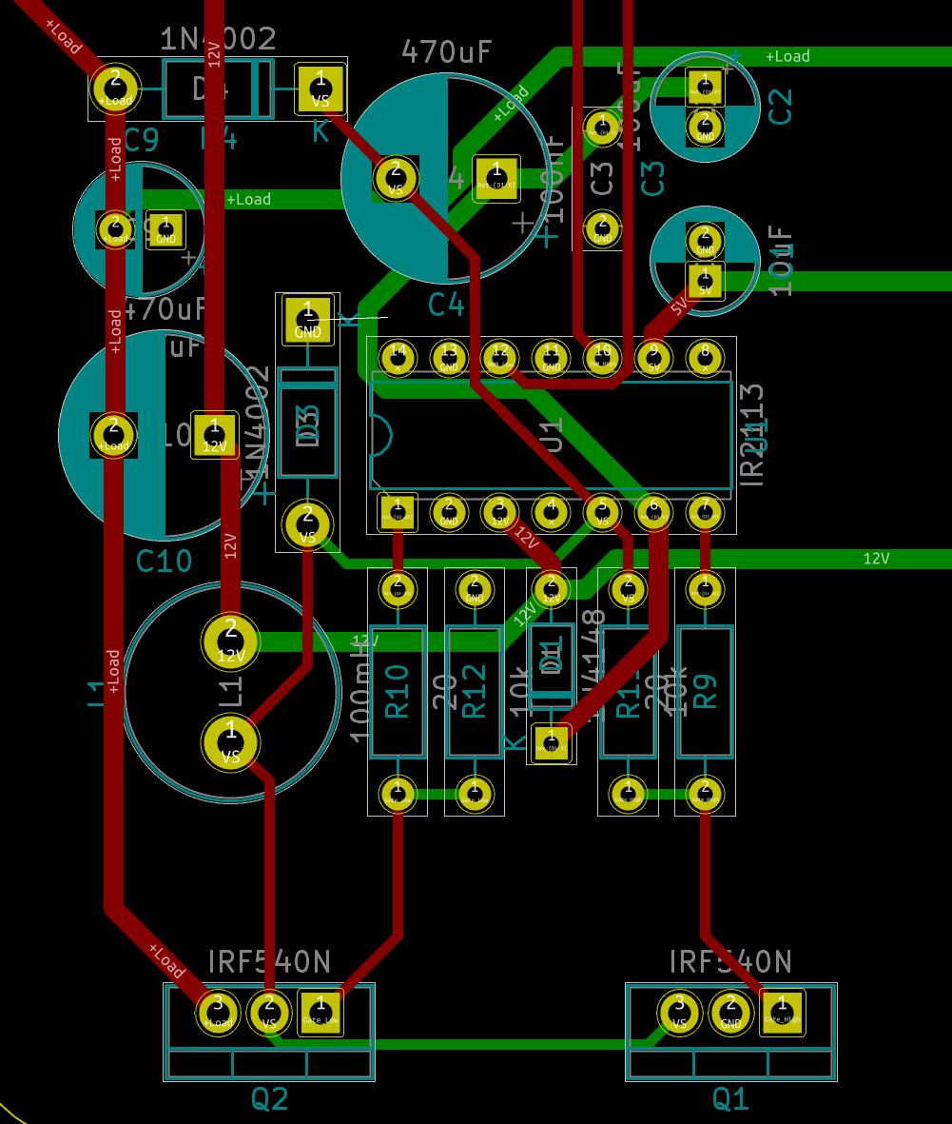
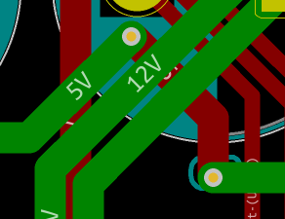
Project analysis slide 10
PCB Design
Issues Seen Throughout

Slide 26
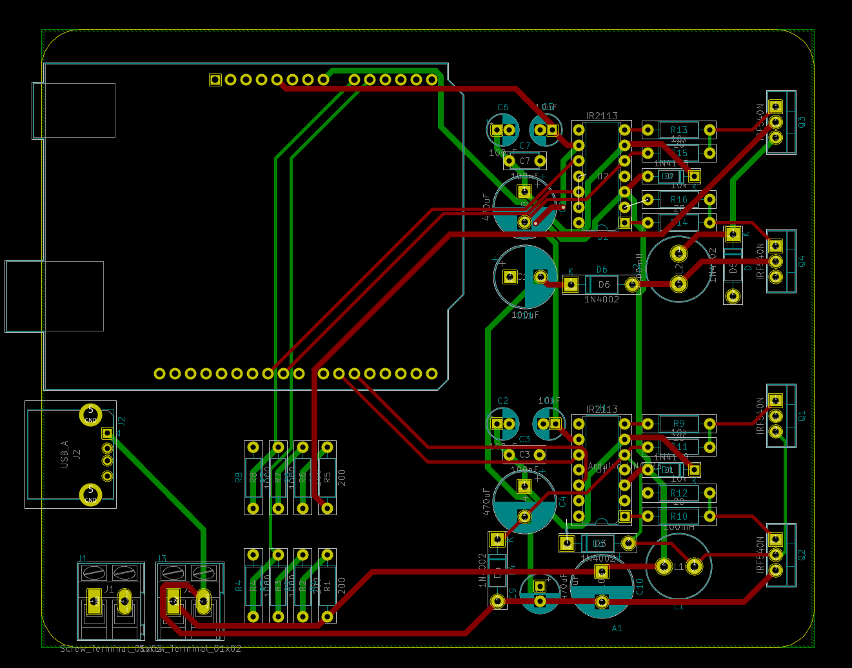
Project analysis slide 10
PCB Design

Slide 27
Conclusion

Slide 28
Project analysis slide 10
Conclusion
First, we think it is important to look back at what we have done and ask, “What could we have done differently?”
Do more research into the project beforehand
Rearrange group members to allow for better workflow
Order more extra parts to begin with
Solidify simulation to prevent clashing with prototyping and PCB design
Completely redesign the PCB for clarity and ease of use
Communicate! Communicate! Communicate!

Slide 29
Project analysis slide 10
Conclusion
We were unable to completely integrate all portions of the project.
Key components were integrated including gate drivers, DC-DC converters, and an Arduino for system control.
Some initial setbacks were overcome, like issues with the Arduino Micro and gate driver implementation.
Through simulations, the system's functioning was made clear. It was shown how the system can increase input voltage to charge devices, charge the battery, and provide power from the battery in situations where the PV input is low.
Overall, it looks like the main goal of creating a functional prototype PV-energy system with battery integration was accomplished, however more work needs to be done to finalize the automation of the system.

Slide 30

Q&A

Slide 31
Thank You

